Slide 1


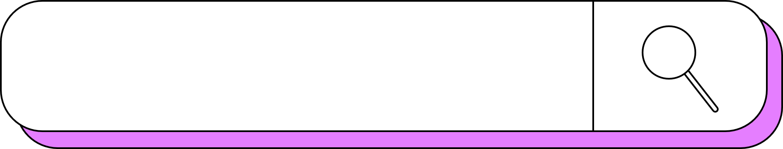
machine learning
PROJECT
by Sanjana V U

Slide 2



contents
1
Introduction to Karunadu Technologies Private Limited
2
What I Learnt ?
3
Projects worked on:
Prediction of Different Spieces of Flower using KNN Algorithm
Classify whether the person is wearing mask or not using Artificial intelligence
4
Conclusion

Slide 3
INTRODUCTION
About the Company
Karunadu Technologies Pvt. Ltd. Is a leading IT software solutions and services industry focussing on quality standards and customer values
Karunadu Technologies Pvt. Ltd. is also a leading Skills and Talent Development company that is building a manpower pool for global industry requirements
Let’s begin!

Slide 4

What I learnt
•Vision and Introduction to Machine Learning.
• Understand Machine Learning Concept
• Good exposure to machine learning algorithms.
• Prediction of values using machine learning algorithms.
• Basics of Python
• Introduction to Artificial Intelligence

Slide 5
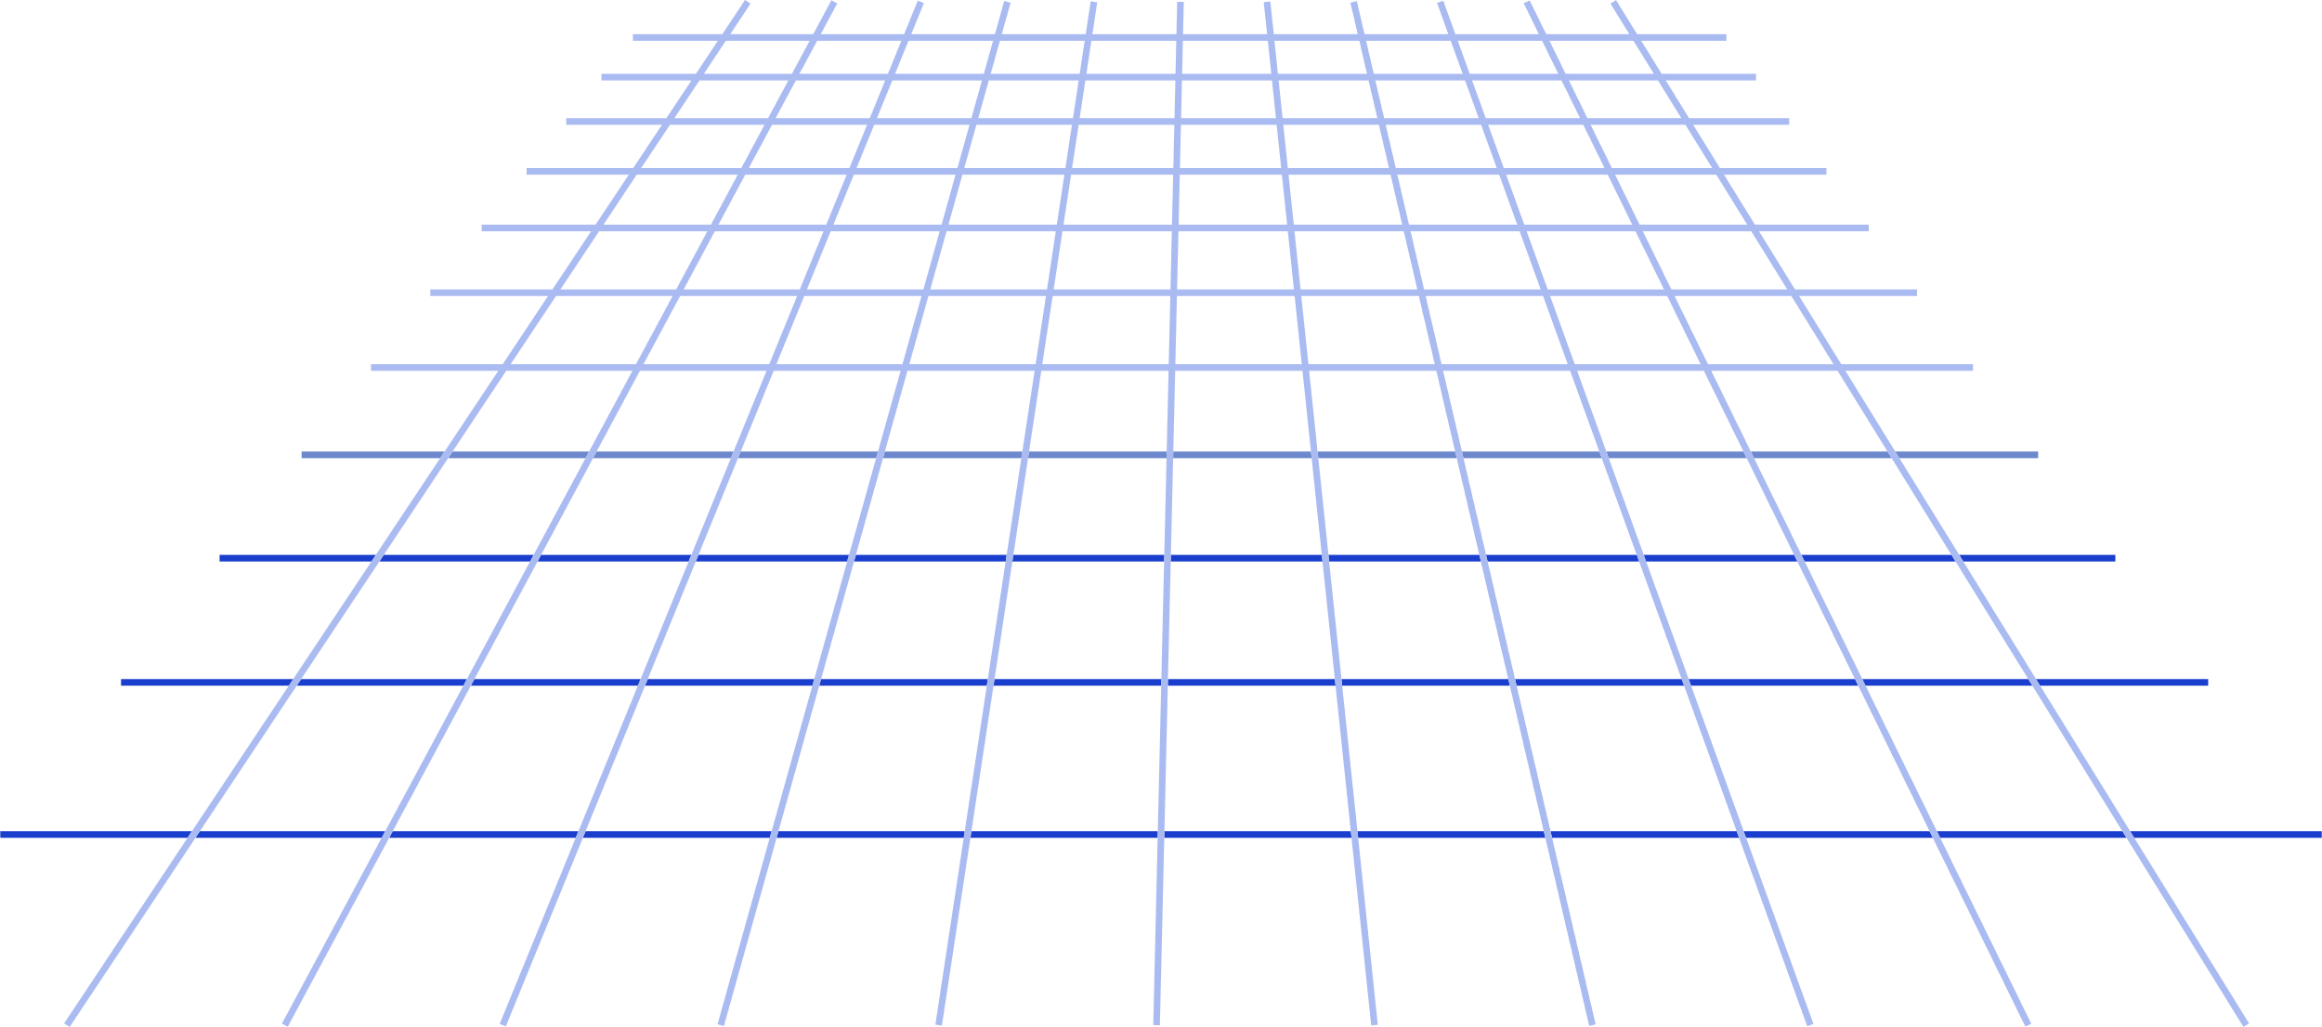
INTRODUCTION TO MACHINE LEARNING
Machine learning (ML) is a type of artificial intelligence (AI) that allows software applications to become more accurate at predicting outcomes without being explicitly programmed to do so. Machine learning algorithms use historical data as input to predict new output values.
Definition: Ability of a machine to improve its own performance through the use of software that employs artificial intelligence techniques to mimic the ways by which humans seem to learn, such as repetition and experience.
Algorithm:
Linear Regression
Logistic Regression
KNN Algorithm
SVM Algorithm
Decision Tree
RandomForestClassifiers

Slide 6
PROJECT I HAVE WORKED ON
Prediction of Different species of Flower using KNN algorithm
In this project, we will develop and evaluate performance and prediction
Different species of flowers using KNN Algorithm
Dataset:
The dataset used in this project consists of variables: AreaCode,LocalityCode,RegionCode,Height ,Diameter,Species,Class

Slide 7

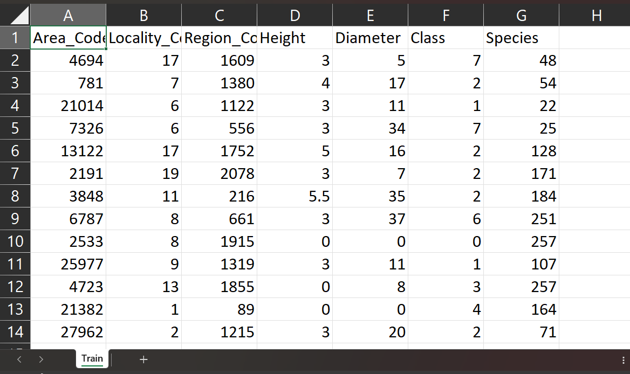
the overview of dataset

Slide 8
algorithm- KNN
The k-Nearest Neighbors (KNN) algorithm is a simple and intuitive machine learning method used for both classification and regression tasks. It operates on the principle that similar instances in a feature space tend to have similar outcomes. KNN classifies a new data point based on the majority class of its k nearest neighbors, where "k" is a user-defined parameter. It does not explicitly learn a model during training, making it a non-parametric and instance-based algorithm. While computationally efficient, KNN's performance can be sensitive to the choice of distance metric and the value of "k."

Slide 9
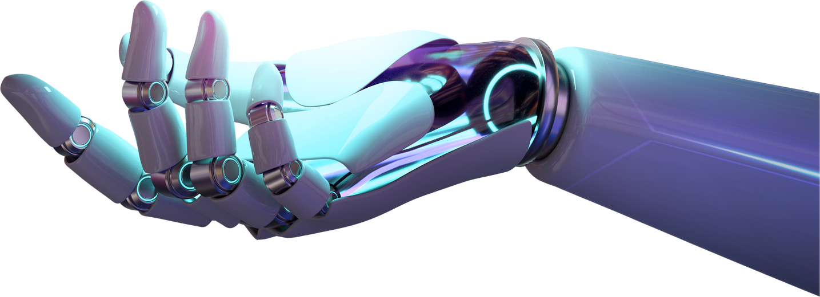
CODE
import pandas as pd
from sklearn.model_selection import train_test_split
from sklearn.neighbors import KNeighborsClassifier
# Load your dataset
# Replace 'your_dataset.csv' with the actual file path
dataset_path = "C:\\Users\\shash\\OneDrive\\Desktop\\internship\\Train.csv"
data = pd.read_csv(dataset_path)
# Display the first few rows of the dataset
print(data.head())

Slide 10
CODE
X = data[['Area_Code', 'Locality_Code', 'Region_Code', 'Height', 'Diameter', 'Class']]
y = data['Species']
X_train, X_test, y_train, y_test = train_test_split(X, y, test_size=0.2, random_state=42)
knn_model = KNeighborsClassifier(n_neighbors=3)
knn_model.fit(X_train, y_train)
Area_Code = float(input("Enter Area Code: "))
Locality_Code = float(input("Enter Locality Code: "))
Region_Code = float(input("Enter Region Code: "))
Height = float(input("Enter Height: "))
Diameter = float(input("Enter Diameter: "))
Class = float(input("Enter Class: "))

Slide 11
CODE
Make a prediction based on user input
user_input = [[Area_Code, Locality_Code, Region_Code, Height, Diameter, Class]]
predicted_species = knn_model.predict(user_input)
# Display the predicted flower species
print(f'Predicted Flower Species: {predicted_species[0]}')

Slide 12
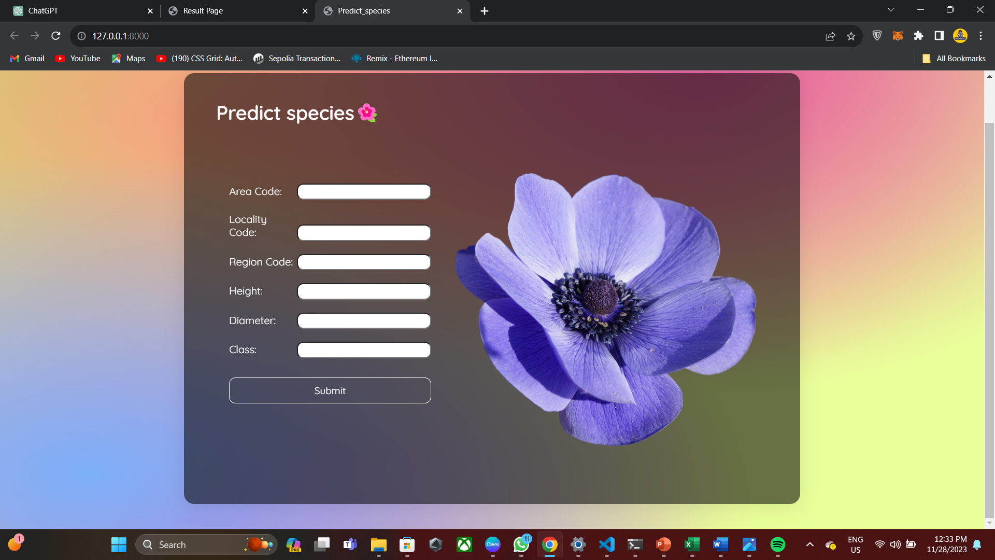
88%
ACCURACY

Slide 13
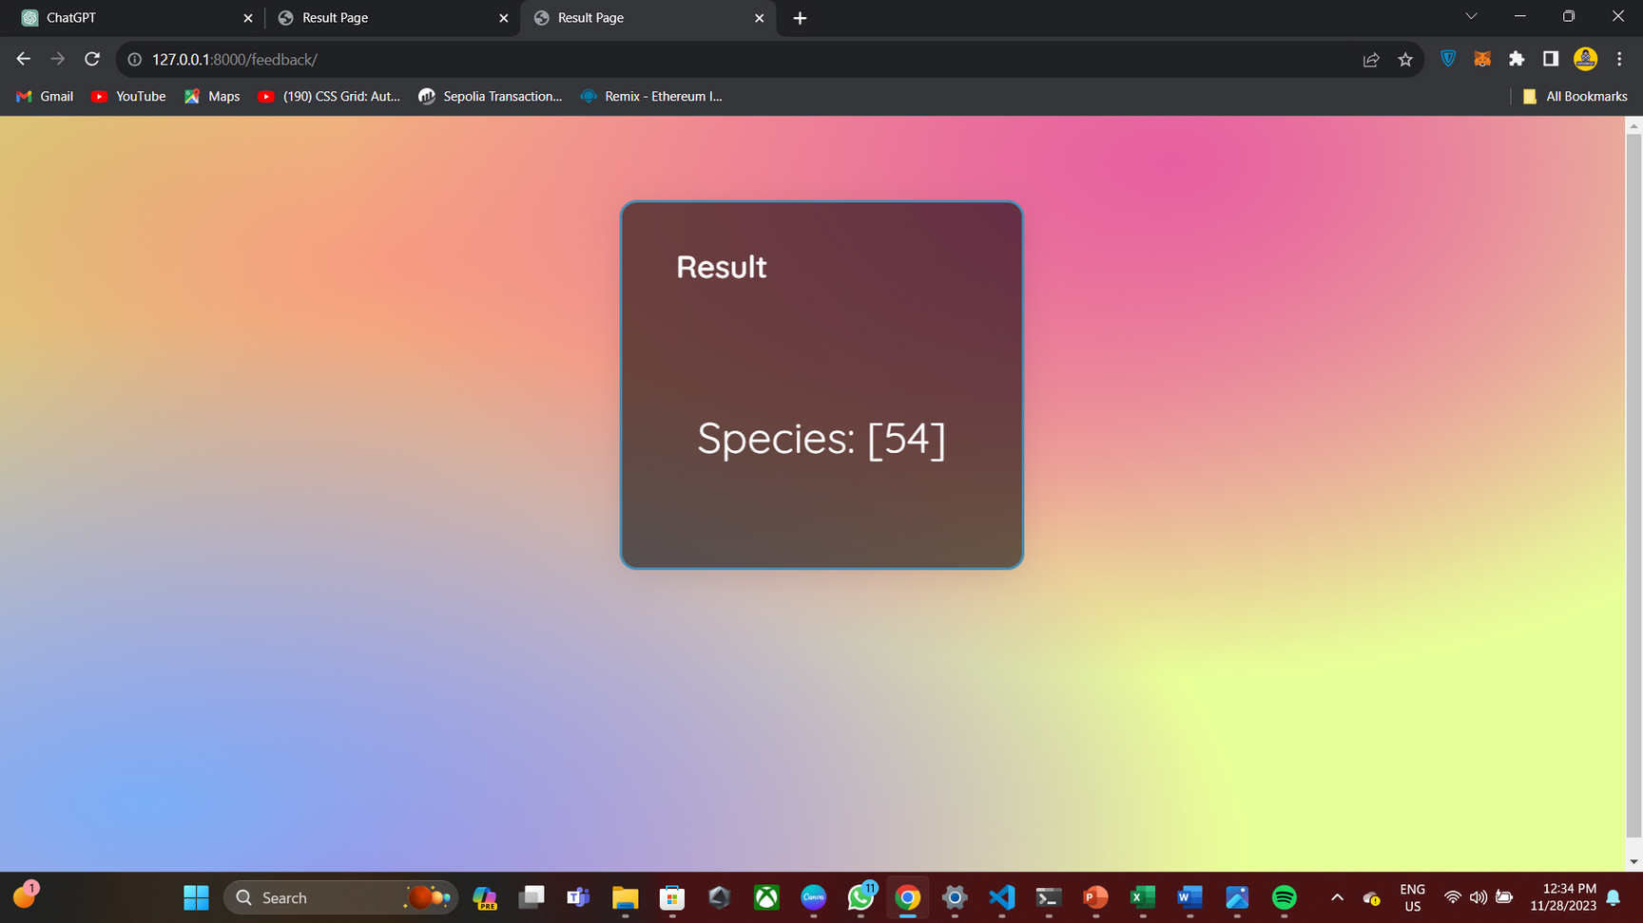

Slide 14
conclusion
In conclusion, the K-Nearest Neighbors (KNN) algorithm is a versatile and intuitive approach for predicting different flower species based on input features such as area code, locality code, region code, height, and diameter. KNN classifies a flower by considering the majority class among its nearest neighbors in the feature space. The choice of the hyperparameter k, representing the number of neighbors, is crucial for the algorithm's performance and should be tuned based on the characteristics of the dataset. While KNN is easy to understand and implement, its effectiveness depends on the distribution and scale of features, and it may require careful preprocessing. Regular testing and validation are essential to ensure the model's generalization to new data.

